Slide 1

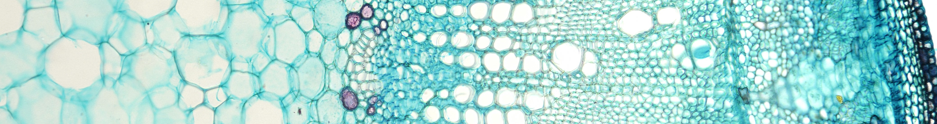


Programming bioimage analysis workflows in python and R using Jupyter Notebook
Date Nom-Prénom

Slide 2
Jupyter Notebook What is it ?
Notes:
<number>

